Slide 1
Single-Page Application
SEIS 752 Class topic
Qiwen hu
Notes:
I’m going to talk about Single-page Application.
Well the single page application is not a strange thing, I believe, for some of you who had an experience on ASP.net. Like Mike has given us a good presentation of AngularJS, and Lloyd once talked about MVC in class. They are all relevant and can be worked together.

Slide 2
Overview
Introduction
background
Dive in SPA
DEMO…
Notes:
Here is the Overview. I’m going to give a brief introduction of SPA, and talk about some backgrounds and we go dive in SPA and we are going to have a Demo of it.

Slide 3
Introduction
SPA == Single-Page Application.
Latest trend
SPA
Single page
Initially load
Dynamically update
User interacts
Notes:
Alright, first of all. I really took a long time to change my mind that SPA actually stands for single-page application, not for message things. I hope that one day doing programming can be like as comfortable as doing message.
Anyway, it’s the latest trend for web development, like next-gen web development, even it’s not that far…
So the SPA is a web application that loads a single HTML page initially and is dynamically updated as the user interacts with the application.

Slide 4
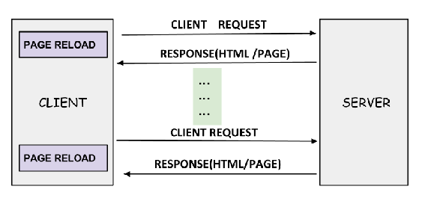
Background
Old-school:
Notes:
We consider the old-school web application that has two main components involved web server and web browser or the client. So every time the client calls the server, the server returns a new HTML page. It takes time to refresh, even when user just clicks a small action on that page. So the traditional web application has some limitations with user interaction, it can be difficult to run in case of limited bandwidth.

Slide 5
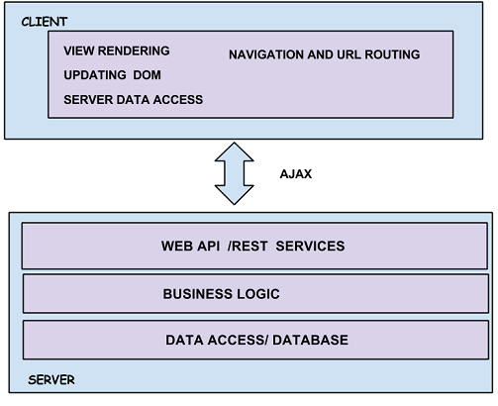
Background (cont.)
Architecture of SPA
All interaction with the server
happens asynchronously
Server side is only run for :
Retrieving and persisting application data
Other resources
Notes:
Comparing with that, SPA uses AJAX and HTML5 to create fluid and responsive Web apps, without constant page reloads. The goal of SPA is to provide the experience to the user which is like a desktop application. The SPA loads initial page as same as the traditional one does. But after that, all interaction with the server happens asynchronously.

Slide 6
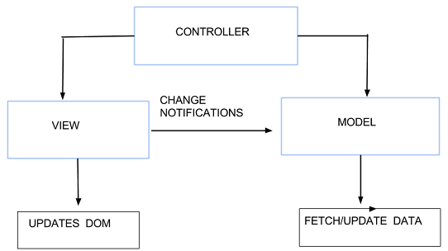
Dive in SPA
SPA is structured as:
Notes:
So SPA is like to transform the missions from server side to client side. It takes some responsibilities from server side, and lets the user deal with them. The SPA is structured as very similar as APS.net MVC, the model takes care of data transformation, view represents model to end user, and the controller ties them together.

Slide 7



Dive in SPA (cont.)
Technologies:
Framework:
Entity Framework
WebAPI
JavaScripts:
AngularJS
Knockout.js
Ember.js
Notes:
So .net developers work with relational data using Entity Framework. WebAPI is also the important framework to build HTTP services and suitable for building RESTful services. There are a lot of useful JavaScript that provide complete supports to build SPA, such as AngularJS, Knockout.js and ember.js.

Slide 8
DEMO…

Slide 9
Q&A
Thank you!

